Slide 1
The Boring Club Week 4

Slide 2
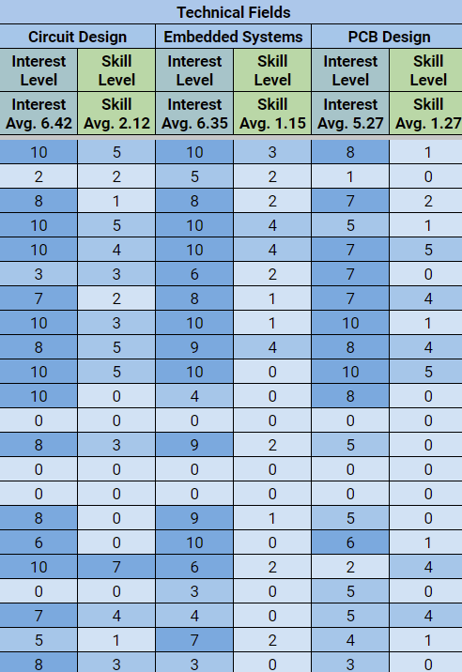
Spreadsheet
Do your check-in right now
This is how I will give Google Drive access to members
Does anyone need access?

Slide 3
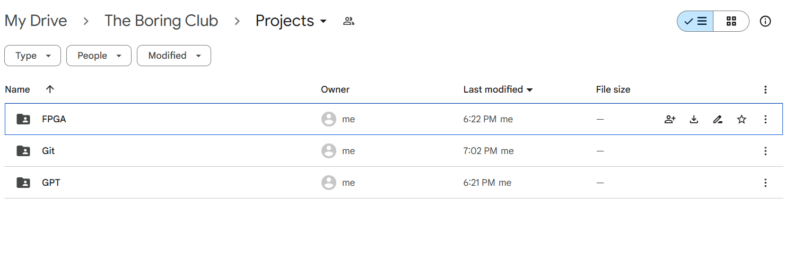
Google Drive
We keep project materials in the Projects folder
You can also find code, schematics, old meeting slides, etc.

Slide 4
Project Status Reports

Slide 5
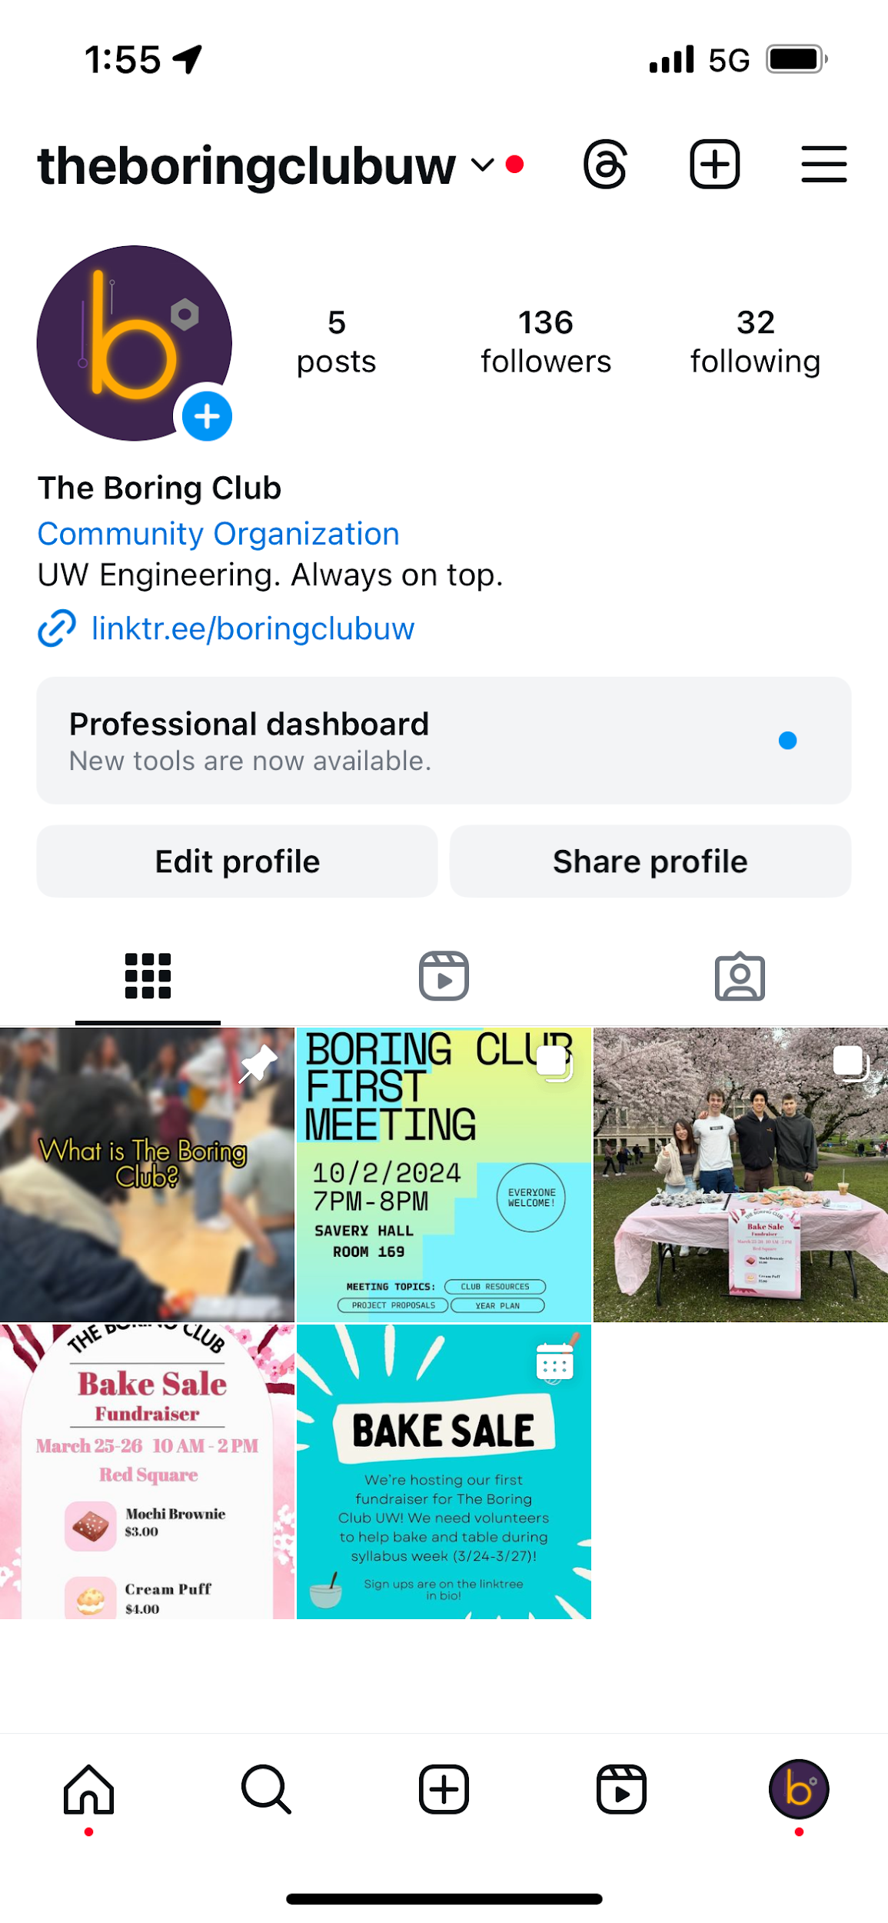
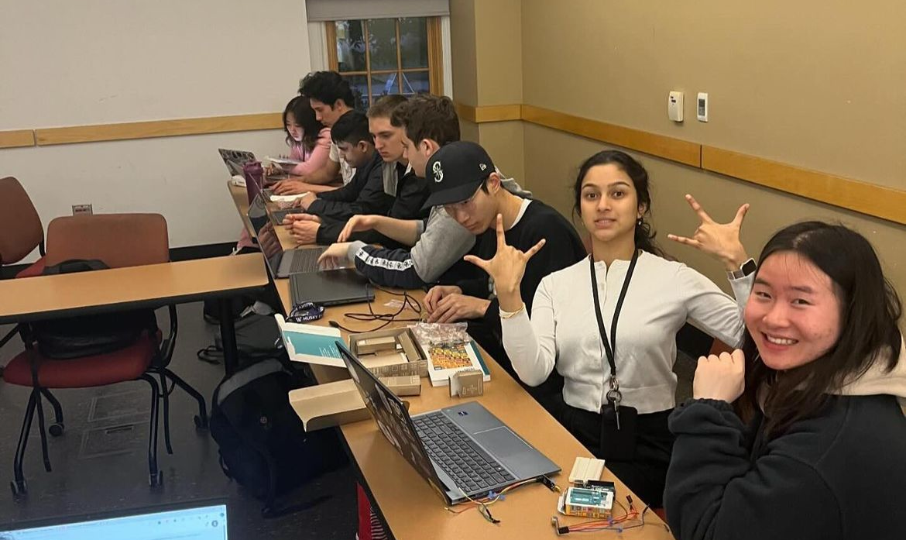
Media Team (Missael)
Social Media, photos, videos

Slide 6
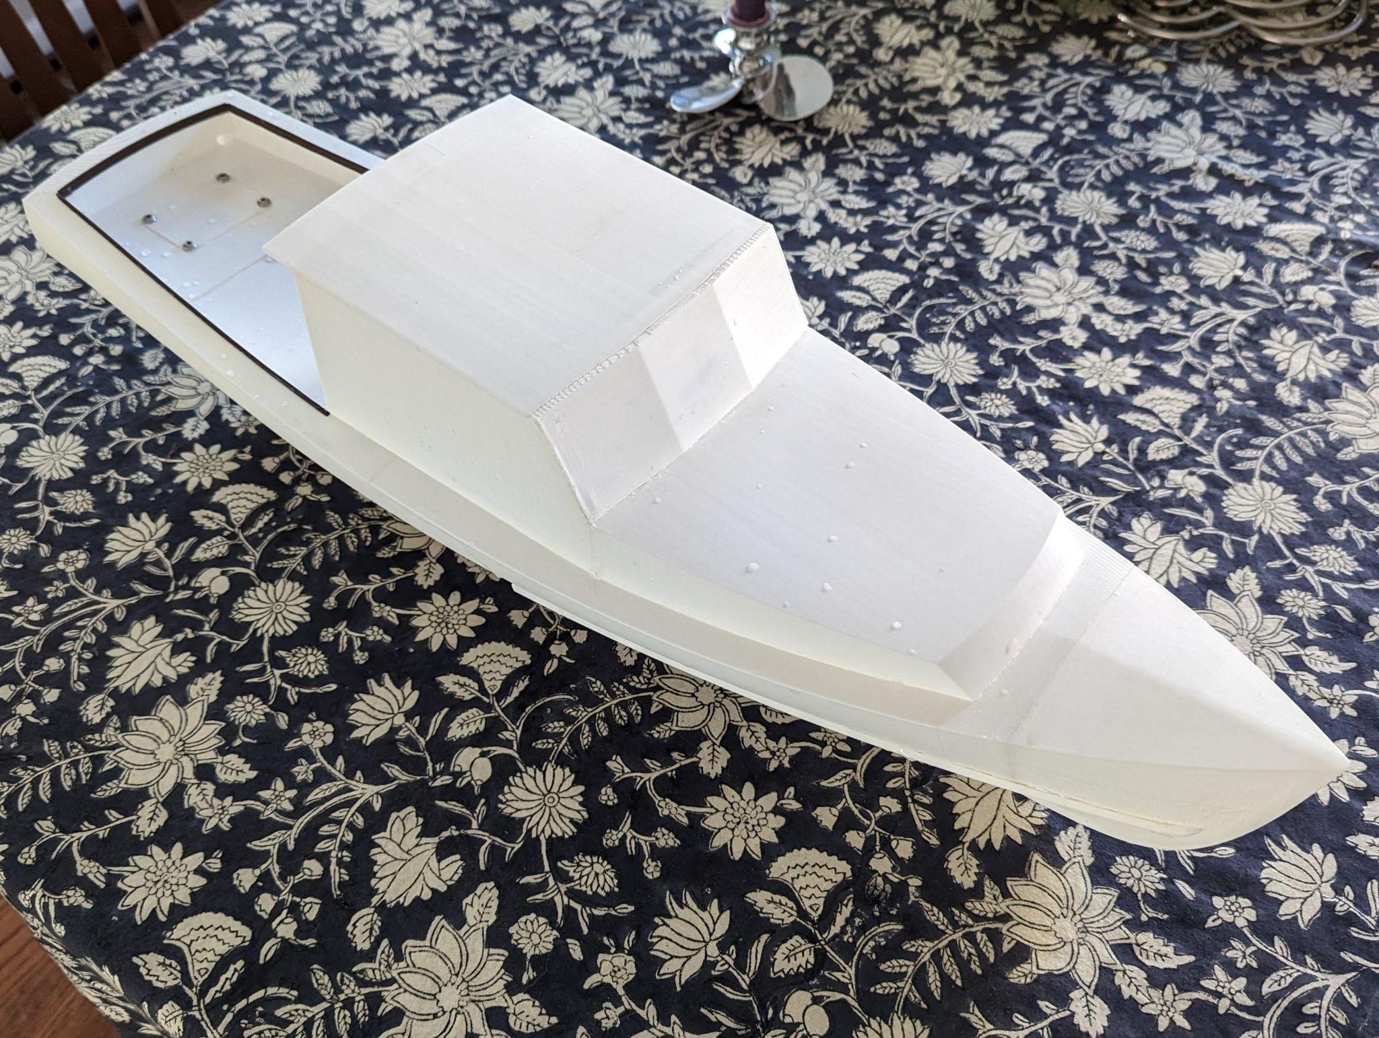
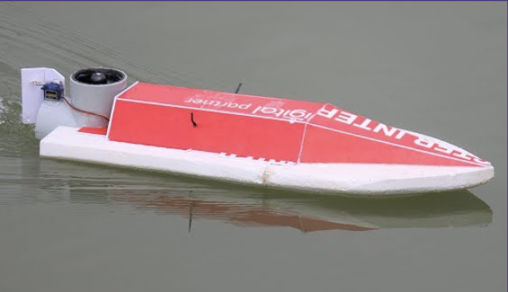
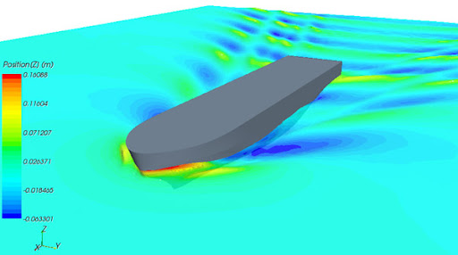
Mini Motorboat (Arjun and Zi)
Last week: Split into sub teams
Discussed a traditional RC boat design and a center design
Electrical: learned how to use a breadboard

Slide 7

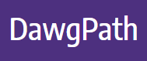
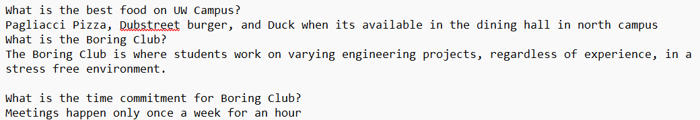
UW GPT (Arshan)
Questions GPT should handle (classes, intramurals, etc.)
Uploading Text Files to GPT (Q&A)
Finding ways to navigate Dawgpath w/JavaScript

Slide 8

Github/Git (Sean)
Set up Git on more peoples local machines and started github profiles
Continued learning basic git cmds, config, commit, add, etc.
Initialize Boring Club Repository
If you are interested, watch this!

Slide 9
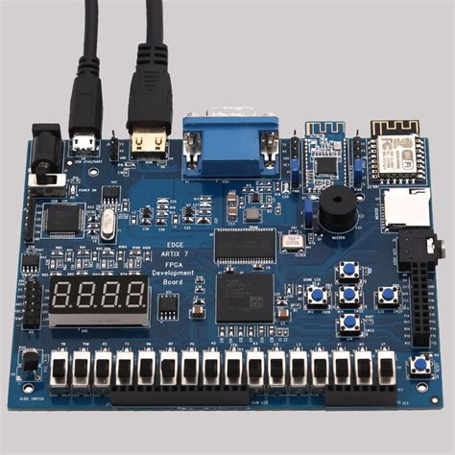
FPGA Digital System Sim (Sam)
Last week Karnaugh Maps (K-maps) and intro to system design
This week we will review everything that we have covered so far

Slide 10
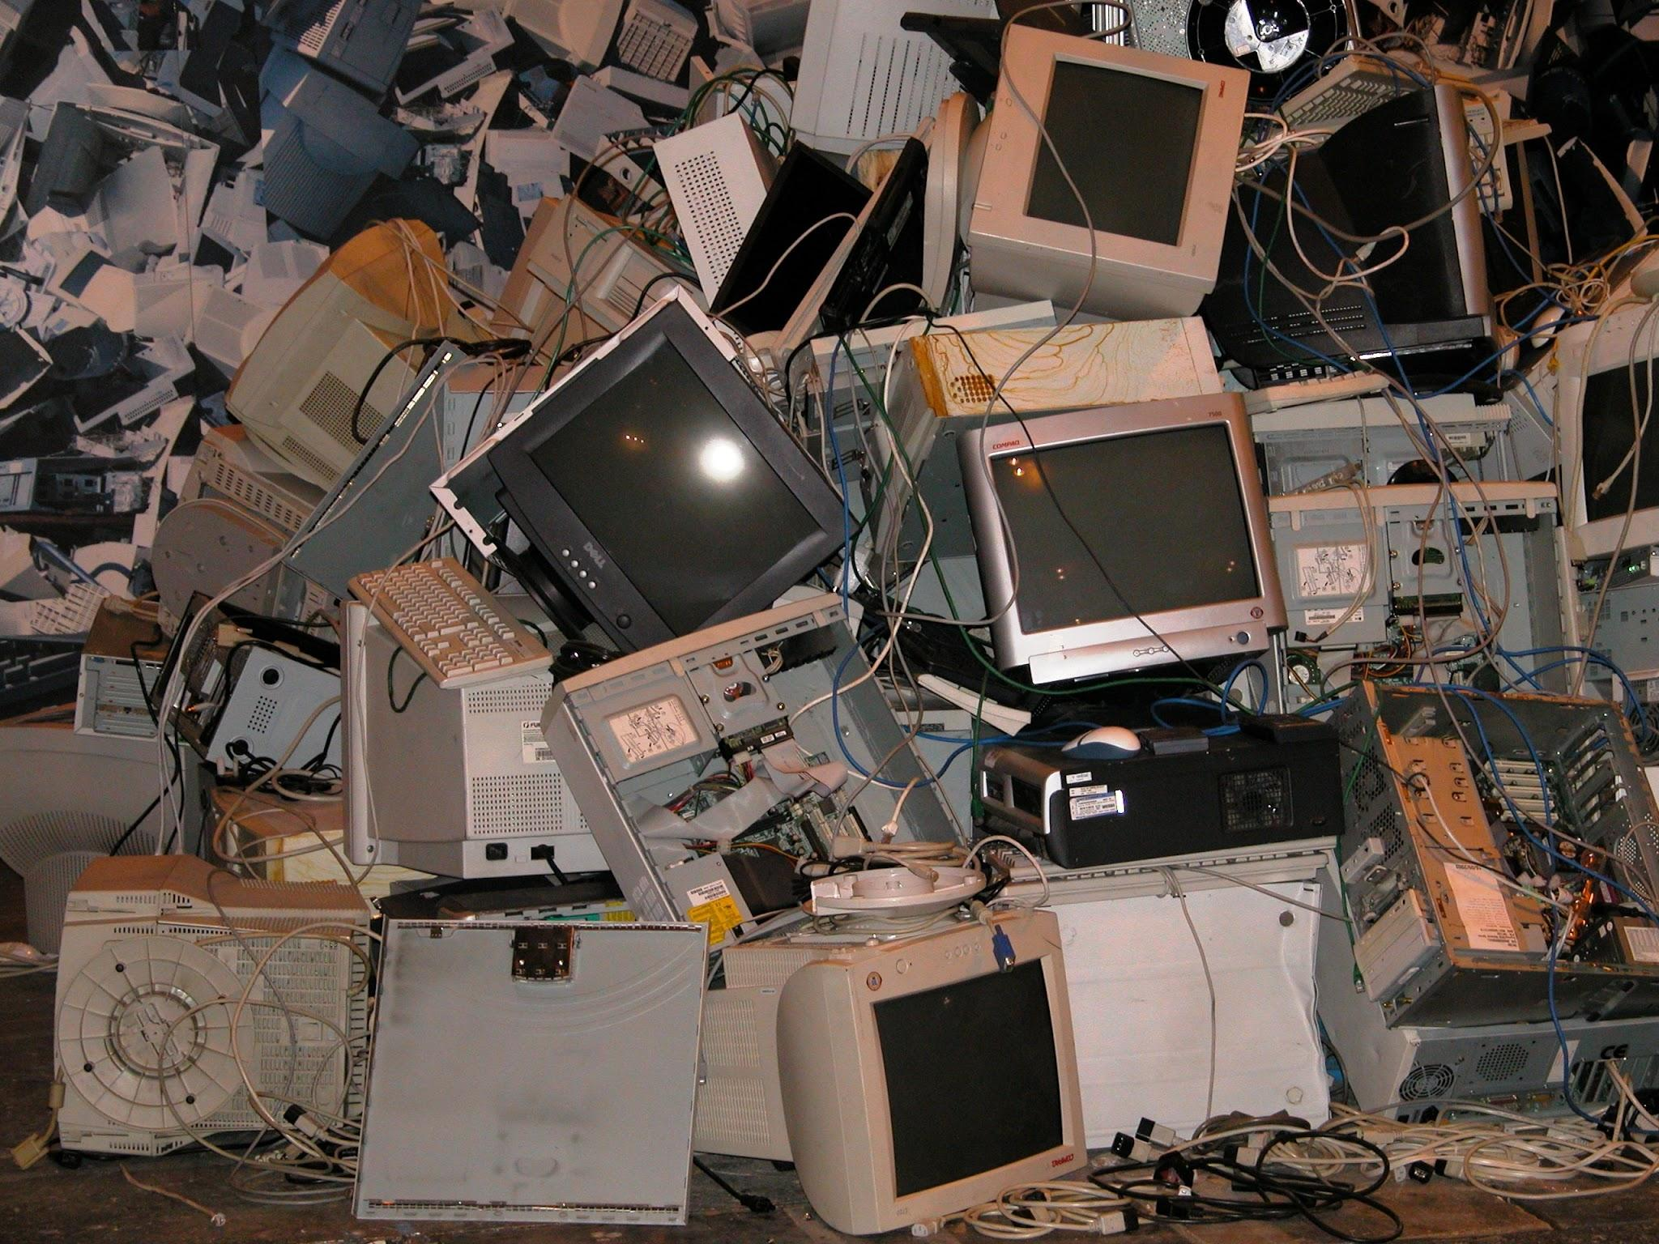

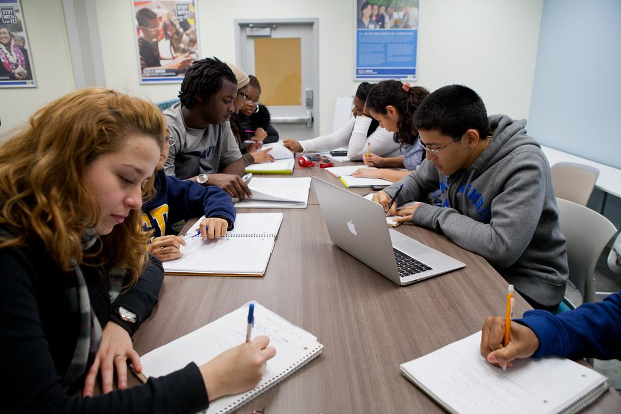
Projects
Let’s get to work!
Notes:
Josh talk about Bot if finished?

